Slide 1
Accuracy of Models

Slide 2
8 Proven Ways for improving the “Accuracy” of a Machine Learning Model
The model development cycle goes through various stages, starting from data collection to model building.
But, before exploring the data to understand relationships (in variables), It’s always recommended to perform hypothesis generation. It is important that you spend time thinking on the given problem and gaining the domain knowledge. So, how does it help?
This practice usually helps in building better features later on, which are not biased by the data available in the data-set. This is a crucial step which usually improves a model’s accuracy.
At this stage, you are expected to apply structured thinking to the problem i.e. a thinking process which takes into consideration all the possible aspects of a particular problem.

Slide 3
1. Add more data
Having more data is always a good idea. It allows the “data to tell for itself,” instead of relying on assumptions and weak correlations. Presence of more data results in better and accurate models.
I understand, we don’t get an option to add more data. For example: we do not get a choice to increase the size of training data in data science competitions. But while working on a company project, I suggest you to ask for more data, if possible. This will reduce your pain of working on limited data sets.

Slide 4
2.Treat missing and Outlier values (Imputation)
The unwanted presence of missing and outlier values in the training data often reduces the accuracy of a model or leads to a biased model. It leads to inaccurate predictions. This is because we don’t analyse the behavior and relationship with other variables correctly. So, it is important to treat missing and outlier values well.
Look at the below snapshot carefully. It shows that, in presence of missing values, the chances of playing cricket by females is similar as males. But, if you look at the second table (after treatment of missing values based on salutation of name, “Miss” ), we can see that females have higher chances of playing cricket compared to males.

Slide 5
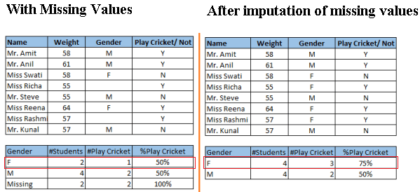

Slide 6
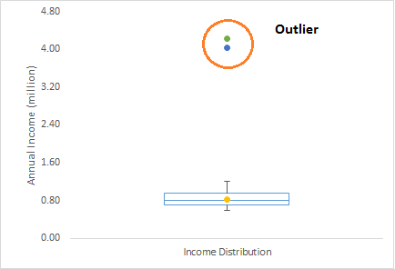
What is an Outlier?
it needs close attention else it can result in wildly wrong estimations. Simply speaking, Outlier is an observation that appears far away and diverges from an overall pattern in a sample.
find out that the average annual income of customers is $0.8 million. But, there are two customers having annual income of $4 and $4.2 million. These two customers annual income is much higher than rest of the population. These two observations will be seen as Outliers.

Slide 7
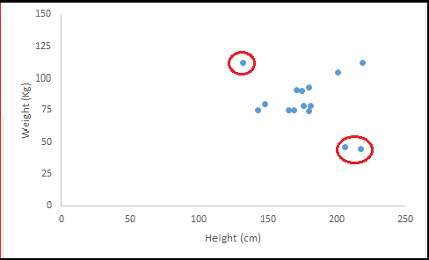
Outlier can be of two types: Univariate and Multivariate
Observe the two values below and one above the average in a specific segment of weight and height.

Slide 8
What is the impact of Outliers on a dataset?
Outliers can drastically change the results of the data analysis and statistical modeling. There are numerous unfavourable impacts of outliers in the data set:
It increases the error variance and reduces the power of statistical tests
If the outliers are non-randomly distributed, they can decrease normality
They can bias or influence estimates that may be of substantive interest
They can also impact the basic assumption of Regression

Slide 9
Treat missing and Outlier values (Imputation)
Methods to remove the adverse effect of missing values on the accuracy of a model.
Missing: In case of continuous variables, you can impute the missing values with mean, median, mode. For categorical variables, you can treat variables as a separate class. You can also build a model to predict the missing values.
Outlier: You can delete the observations, perform transformation, binning, Imputation (Same as missing values) or you can also treat outlier values separately.

Slide 10
3. Feature Engineering
This step helps to extract more information from existing data. New information is extracted in terms of new features. These features may have a higher ability to explain the variance in the training data. Thus, giving improved model accuracy.
Feature engineering is highly influenced by hypotheses generation. Good hypothesis result in good features. That’s why, I always suggest to invest quality time in hypothesis generation. Feature engineering process can be divided into two steps:
A) Feature Transformation
B) Feature Creation

Slide 11
A) Feature transformation
A) Changing the scale of a variable from original scale to scale between zero and one. This is known as data normalization.
For example: If a data set has 1st variable in meter, 2nd in centi-meter and 3rd in kilo-meter, in such case, before applying any algorithm, we must normalize these variable in same scale.
B) Some algorithms works well with normally distributed data. Therefore, we must remove skewness of variable(s). There are methods like log, square root or inverse of the values to remove skewness.

Slide 12
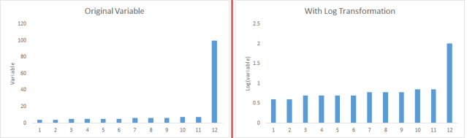
C) Some times, creating bins of numeric data works well, since it handles the outlier values also. Numeric data can be made discrete by grouping values into bins. This is known as data discretization.

Slide 13
B) Feature Creation
Deriving new variable(s ) from existing variables is known as feature creation.
It helps to unleash the hidden relationship of a data set.
Let’s say, we want to predict the number of transactions in a store based on transaction dates.
Here transaction dates may not have direct correlation with number of transaction, but if we look at the day of a week, it may have a higher correlation.
In this case, the information about day of a week is hidden. We need to extract it to make the model better.

Slide 14

4. Feature Selection
Feature Selection is a process of finding out the best subset of attributes which better explains the relationship of independent variables with target variable.

Slide 15
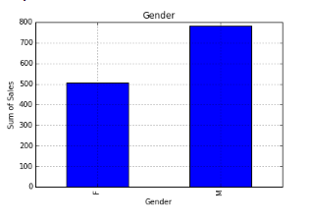
4. Feature Selection
You can select the useful features based on various metrics like:
Domain Knowledge: Based on domain experience, we select feature(s) which may have higher impact on target variable.
Visualization: As the name suggests, it helps to visualize the relationship between variables, which makes your variable selection process easier.

Slide 16
5. Multiple algorithms
Hitting at the right machine learning algorithm is the ideal approach to achieve higher accuracy.
This intuition comes with experience and incessant practice. Some algorithms are better suited to a particular type of data sets than others.
Hence, we should apply all relevant models and check the performance.
USE CHEAT SHEET

Slide 17
6. Algorithm Tuning
We know that machine learning algorithms are driven by parameters. These parameters majorly influence the outcome of learning process.
The objective of parameter tuning is to find the optimum value for each parameter to improve the accuracy of the model.
To tune these parameters, you must have a good understanding of these meaning and their individual impact on model. You can repeat this process with a number of well performing models.
For example: In random forest, we have various parameters like max_features, number_trees, random_state, oob_score and others. Intuitive optimization of these parameter values will result in better and more accurate models.

Slide 18
7. Ensemble methods
This is the most common approach found majorly in winning solutions of Data science competitions. This technique simply combines the result of multiple weak models and produce better results. This can be achieved through many ways:
Bagging (Bootstrap Aggregating)
Boosting

Slide 19
8. Cross Validation:
Cross Validation is one of the most important concepts in data modeling.
It says, try to leave a sample on which you do not train the model and test the model on this sample before finalizing the model.

